Slide 1

Connected Components in Graphs
Data Structure | Graph
Course: Data Structure | Chapter: Graph | Bachelor of Engineering
DISCOVER · LEARN · EMPOWER
Notes:
Welcome to today's lecture on Connected Components within the Graph chapter. We will explore how to identify isolated subgraphs in a network. This concept is fundamental for analyzing connectivity in real-world systems like social networks or road maps.

Slide 2
Course Outcomes
SLIDE 2 / 14
Course Outcome
CO | BT LEVEL | DESCRIPTION
CO1 | BT1 | Understand and apply basic data structures, algorithms, complexity analysis, ADTs, arrays and linked lists.
CO2 | BT2 | Apply and implement stacks and queues in problem-solving.
CO3 | BT3 | Analyse and apply searching, sorting, and hashing techniques.
CO4 | BT4 | Construct and apply tree structures and traversal techniques.
CO5 | BT5 | Represent and solve graph problems using DFS, BFS, and graph algorithms.
Chandigarh University
2 / 14
Notes:
Today's lecture directly addresses CO2 by applying traversal algorithms like DFS and BFS which utilize stacks and queues. We also address CO3 as we analyze graph connectivity, a critical step in searching and data analysis techniques.

Slide 3
Learning Objectives
SLIDE 3 / 14
Learning Outcomes
1
Define a connected component in an undirected graph.
2
Differentiate between connected and disconnected graph structures.
3
Apply Depth First Search to identify component sets.
4
Count the total number of connected components in a graph.
5
Analyze time complexity of component identification algorithms.
Chandigarh University
3 / 14
Notes:
By the end of this session, you will be able to define what makes a graph connected. You will learn to distinguish isolated islands of nodes from a single unified network. We will practice counting these components using standard traversal methods.

Slide 4
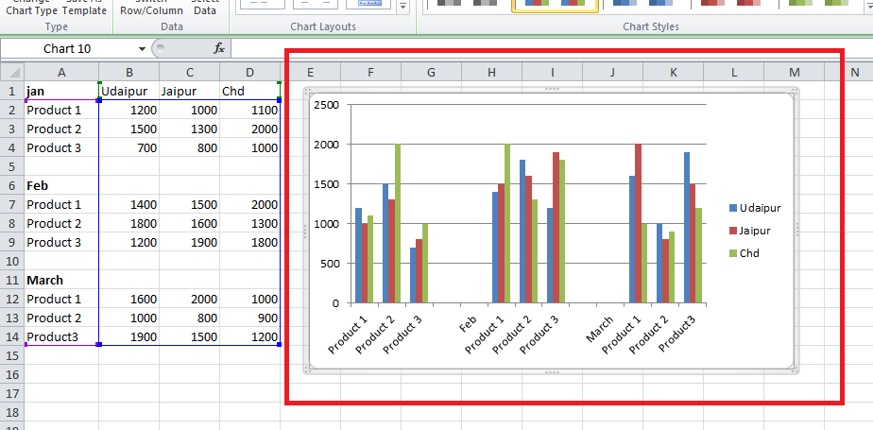
Lecture
SLIDE 4 / 14
Definition of Connected Component
1
A connected component is a maximal connected subgraph.
2
Every pair of vertices in the component has a path.
3
No vertex in the component connects to outside vertices.
4
Maximal means no larger connected subgraph contains it.
5
A single isolated vertex counts as one component.
6
Components partition the vertex set of the graph.
How to Graph Three Sets of Data Criteria in an Excel Clustered Column Chart? - GeeksforGeeks
Chandigarh University
4 / 14
Notes:
Think of a connected component as an island in a sea of nodes. Every node on the island can reach every other node on that same island. However, there are no bridges connecting this island to any other landmass in the graph.

Slide 5
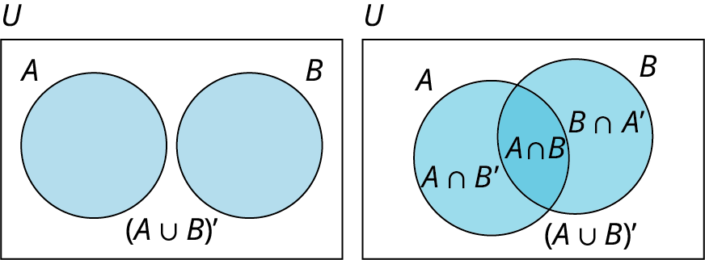
Lecture
SLIDE 5 / 14
Properties of Connected Components
1
Components are disjoint sets of vertices with no overlap.
2
The union of all components equals the original graph.
3
Edges only exist within a component, never between them.
4
A connected graph has exactly one connected component.
5
An empty graph with n vertices has n components.
6
Components are unique regardless of traversal starting point.
Source: math.libretexts.org
Chandigarh University
5 / 14
Notes:
These components act like disjoint sets in mathematics. They never share vertices or edges with each other. If you take all these separate pieces and put them together, you reconstruct the entire original graph structure perfectly.

Slide 6
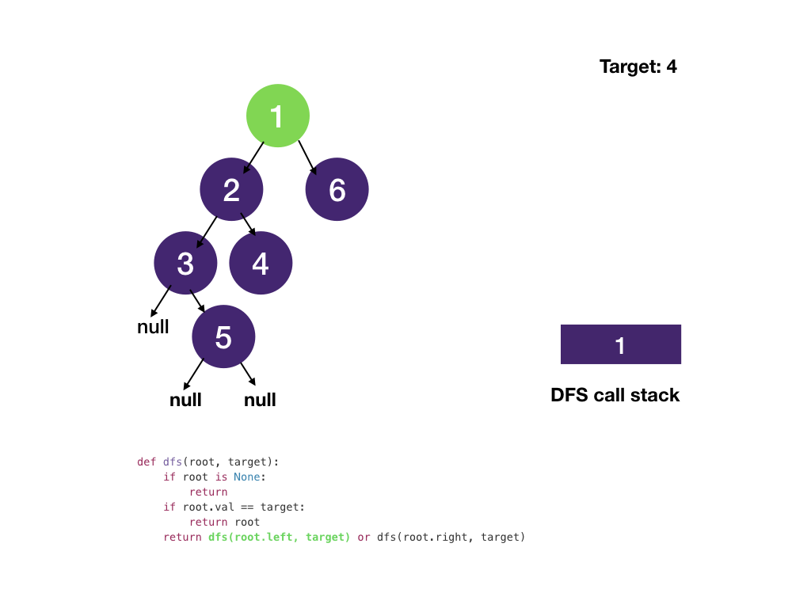
Algorithm
SLIDE 6 / 14
DFS Approach
1
Initialize all vertices as unvisited before starting.
2
Iterate through every vertex in the graph sequentially.
3
If a vertex is unvisited, start a new component.
4
Launch Depth First Search from the current vertex.
5
Mark all reachable vertices as visited during traversal.
6
Increment component counter after each DFS call finishes.
Source: assets.algo.monster
Chandigarh University
6 / 14
Notes:
We use Depth First Search to explore each island fully before moving on. We loop through every node; if we find an unvisited one, it must be a new island. We then dive deep to mark all reachable nodes as part of that island.

Slide 7
Algorithm
SLIDE 7 / 14
BFS Approach
1
Initialize all vertices as unvisited at the start.
2
Iterate through every vertex in the graph sequentially.
3
If a vertex is unvisited, start a new component.
4
Launch Breadth First Search using a queue structure.
5
Mark all reachable neighbors as visited level by level.
6
Increment component counter after each BFS call finishes.
Chandigarh University
7 / 14
Notes:
Breadth First Search works similarly but explores neighbors level by level. We use a queue to manage the order of visiting nodes. Like DFS, every time we start a fresh search from an unvisited node, we have found a new component.

Slide 8
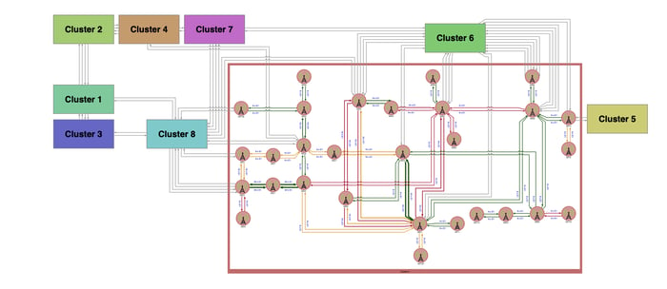
Worked Example
SLIDE 8 / 14
Graph Setup
EDGES EXIST
(0,1), (1,0), (2,3), (3,2), (4,5).
• Consider a graph with 7 vertices labeled 0 to 6.
• Vertex 6 has no edges connected to any other node.
• Vertices 0 and 1 form one connected group.
• Vertices 2 and 3 form a second connected group.
• Vertices 4 and 5 form a third connected group.
Source: www.tomsawyer.com
Chandigarh University
8 / 14
Notes:
Let's visualize a graph with seven nodes. We have three pairs of connected nodes and one lonely node. Node 0 connects to 1, node 2 to 3, and node 4 to 5. Node 6 stands completely alone with no connections.

Slide 9
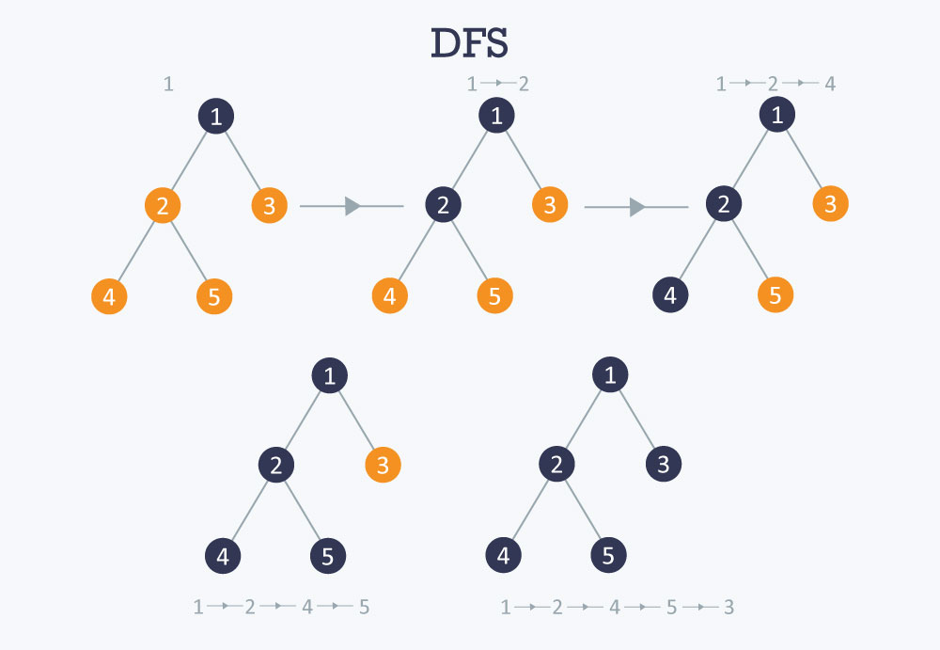
Worked Example
SLIDE 9 / 14
Traversal Steps
1
Start at vertex 0; it is unvisited, so component 1 begins.
2
DFS visits 0, then 1; both are now marked visited.
3
Move to vertex 1; it is already visited, skip it.
4
Move to vertex 2; it is unvisited, so component 2 begins.
5
DFS visits 2, then 3; both are now marked visited.
6
Move to vertex 3; it is already visited, skip it.
Source: he-s3.s3.amazonaws.com
Chandigarh University
9 / 14
Notes:
We start at node 0 and find node 1, marking both as visited. This completes our first island. We skip node 1 since it's done. Then we find node 2 is new, so we start our second island and visit node 3.

Slide 10
Worked Example
SLIDE 10 / 14
Final Count
1
Move to vertex 4; it is unvisited, so component 3 begins.
2
DFS visits 4, then 5; both are now marked visited.
3
Move to vertex 5; it is already visited, skip it.
4
Move to vertex 6; it is unvisited, so component 4 begins.
5
DFS visits 6; no neighbors exist, traversal ends.
6
Total connected components in this graph is exactly 4.
Chandigarh University
10 / 14
Notes:
We continue to node 4, finding node 5, completing the third island. Finally, we reach node 6, which is isolated. Since it has no neighbors, the traversal ends immediately. We have identified four distinct connected components in total.

Slide 11
Lecture
SLIDE 11 / 14
Time Complexity Analysis
1
Each vertex is visited exactly once during the process.
2
Each edge is traversed exactly twice in undirected graphs.
3
Total time complexity is O(V + E) for adjacency lists.
4
Total time complexity is O(V²) for adjacency matrices.
5
Space complexity is O(V) for the visited array.
6
Space complexity is O(V) for recursion stack in DFS.
Chandigarh University
11 / 14
Notes:
The efficiency depends on how we store the graph. With an adjacency list, we touch every node and edge once, giving us linear time relative to the graph size. This is highly efficient for sparse graphs where edges are few.

Slide 12
Common Pitfalls
SLIDE 12 / 14
Logic Errors
1
Forgetting to iterate through all vertices in the loop.
2
Starting DFS only from the first vertex of the graph.
3
Not resetting the visited array between different graphs.
4
Counting components inside the DFS instead of the loop.
5
Treating directed graphs as undirected without checking.
6
Assuming a graph is connected without verification.
Chandigarh University
12 / 14
Notes:
A common mistake is only starting the search from node zero. If the graph is disconnected, you will miss other islands entirely. You must loop through every single node to ensure no component is left uncounted.

Slide 13
Lecture
SLIDE 13 / 14
Key Takeaways
1
Connected components are maximal sets of mutually reachable vertices.
2
Disjoint components partition the entire vertex set of a graph.
3
DFS and BFS are standard algorithms to identify components.
4
The algorithm requires iterating all vertices to count correctly.
5
Time complexity is linear O(V + E) for adjacency lists.
Chandigarh University
13 / 14
Notes:
Remember that components are isolated islands within a larger network. You must check every node to ensure you find all islands. Using DFS or BFS allows you to efficiently map out these structures in linear time.

Slide 14
Lecture
SLIDE 14 / 14
References
DATA STRUCTURES
A Pseudocode Approach with C — Gilberg, Forouzan
• Data Structures — Lipschutz
• Data Structure Using C — AK Sharma
• C and Data structure — P. S. Deshpandey
Chandigarh University
14 / 14
Notes:
These textbooks provide comprehensive coverage of graph algorithms and data structures. Please refer to the chapters on graphs for deeper theoretical insights and additional practice problems. They are essential resources for mastering this topic.

